Slide 1
Back Button
Wearable communications and emergency device for hazardous construction sites
CSCI E-78 Wearable Technologies & IoT
Project 1
Brett Bloethner
Notes:
CSCI E-78 Wearable Technologies and IoT
Project 1
Brett Bloethner

Slide 2
The Problem and opportunity
Poor communication leads to dysfunctional jobsites
Jobsite accidents
71,730 Construction injuries were reported in 2017 alone
Construction accounts for 21% of work related deaths
Project rework
On average, rework accounts for 9% of total project cost
Employee dissatisfaction
Construction firms see a 25% employee turnover rate on average
It costs at least $3,200 to find and replace a low hourly wage employee
High levels of communication will enable jobsite management to…
Achieve coordinated results
Manage activity
Understand the needs of the workplace
Motivate employees
Notes:
Construction job sites are notoriously dangerous, chaotic, disorganized, and inefficient.
Jobs in the construction industry add up to less than 5% of all employment in the United States yet they account for one fifth of all work related deaths.
71,000 construction injuries were reported in 2017 alone and data shows that nearly every construction worker will experience at least on work related injury in their career
Accidents aren’t the only thing that cost construction firms massive amounts of money though. Rework accounts for nearly one tenth of all construction project’s cost on average and is often a product of simple and careless miscommunication through daily field crew meetings or simply yelling across the job site or into a megaphone.
This all leads to employee dissatisfaction and ultimately, employee turnover. A low wage jobsite worker costs at least $3,200 to replace and many firms have turnover rates in the mid 20% range.
According Andrew Dainty’s book “Communication in Construction: Theory and Practice,” achieving high levels of communication will enabled construction firms to better achieve results, manage activity, understand the workplace, and motivate employees and each of these ultimately result in lowering what it costs for a construction firm to do business by doing business with less risk and rework, and happier employees.

Slide 3
Back button’s Purpose
Back Button is a wearable voice communication, notification, and emergency beacon device for construction workers. It serves three purposes…
Enable instant communication across teams and across the job site
Enable instant notifications and emergency beacons across the job site
Enable management to mitigate risk through monitoring workers physiological state
As a result, the Back Button system will…
Decrease the cost of rework by promoting real time collaboration and decreasing the amount of rework needed
Decrease risk on the jobsite by enabling management to address injuries and hazardous conditions immediately as they occur
Decrease employee turnover by making their work safer and more relevant (less redoing work)
Notes:
Back Button is a small and easy to use wearable communication tool, notification tool, and emergency beacon for the job site.
Simply attach it to the back of your shirt collar or the back of your hard hat and with the press of a button you get instant communication with your team from anywhere.
Hold the button for 10 seconds and you’ll activate the emergency beacon. This button could save your life by instantly notifying nearby workers and jobsite managers that you’re in need of emergency assistance.
Back Button works for management as well. A PPG sensor clipped to the ear lobe and plugged into the Back Button monitors workers’ physiological signs and notifies management when a worker may be subject to unnecessary risk from over exhaustion.
The result? Better and instant communication. A safer work environment. Less rework, more real work, and fewer injuries.

Slide 4
Benefits and Advantages
Back Button increases the observability of workers
Allowing management to better identify work related physiological stress risks before the risk results in injuries and additional costs
Back Button promotes communication between jobsite workers
Increasing collaboration and decreasing rework by enabling instant communication of status, needs, and requirement changes
Back Button instantly and reliably notifies jobsite workers of hazards
Decreasing risk by enabling management to instantly and reliably warn the jobsite of sever weather or other potentially dangerous conditions and address how to proceed safely
Back Button instantly seeks help after serious accidents
Decreasing the severity of injuries after jobsite accidents by alerting management and nearby workers of emergencies and injuries instantly after they occur, reducing the time to hospital or care
RESULT:
Reduced risk = Lower cost to complete job & higher employee satisfaction
Reduced rework = Lower cost to complete job & higher employee satisfaction
Higher Employee Satisfaction = Lower employee turnover
Notes:
Benefits and advantages of the Back Button system include better observability of your workforce, better communication across the jobsite, quick hazard notification and the ability to rapidly respond to serious jobsite accidents. Each of these is cost saving but also helps leads to higher employee satisfaction which leads the lower employee turnover and more money saved.

Slide 5
Scenario one
Emergency beacon features is used to report a critical injury
Scenario one uses the Back Button emergency beacon feature
Press and hold the main button for 10 seconds to activate the feature
Power cycle the device to deactivate the feature
Back Button device emits a siren and LED strobe pattern
The emergency beacon location (GPS coordinates) are reported to the Back Button cloud service which then sends a push notification to all other devices in the system
Forman app instances in the system receive notification of the emergency beacon
All other Back Button devices ‘nearby’ receive a notification of the beacon
Notes:
Scenario one involves the Back Button emergency beacon. To activate the beacon you simply hold the main button for 10 seconds. Then button will sound an alarm and begin to strobe bright red as it notifies all other Back Button devices on the job site and Forman app instances that you’re in need of emergency assistance.

Slide 6
Scenario one Interaction Flow
Emergency beacon features is used to report a critical injury
John arrives at the construction jobsite with the Back Button he charge overnight at home. He attaches it to his shirt collar, inserts the earpiece, and clips on the earlobe sensor.
While working in a loud area of the jobsite, he falls 15 ft. into an unattended room. His fall and serious injuries go unnoticed.
He presses and holds the Back Button device for 10 seconds, activating the emergency beacon feature.
Managers and nearby workers are notified of the situation via an automated alert in their earpiece. John's beacon is now sounding a high dB alarm and strobing bright red.
He works the majority of the day, receiving notifications and communications from his team through his earpiece.
Workers in a nearby area look for and find John almost immediately and begin tending to his injuries. One worker calls emergency services.
John is transported to the hospital where his injuries are treated.
Because of the Back Button
Johns time to hospital was decreased significantly
Johns injuries we treated more promptly
Notes:
No notes here. Reading off the slide.

Slide 7
Scenario two
Voice communication feature is used for collaboration and team work
Scenario two uses the Back Button voice communication feature
One press on the Back Button opens a communication channel with that device’s team or, in response to a direct voice message, opens a two way conversation
Two presses on the Back Button opens a communication channel with that device’s team’s leader
Additional custom configuration can be made via the Back Button Admin web app for three and four button presses
Receiving Back Button devices receive the voice communication in real time
The message is terminated once the mic detects no audio for a specified number of seconds
Notes:
Scenario two uses a simple two way communication feature. The user receives a message from their team leader and quickly responds by pressing the Back Button and continuing a short concise conversation about a change in their building requirements. This interaction successfully averts having to do rework after the requirements change.

Slide 8
Scenario two interaction flow
Voice communication feature is used for collaboration and team work
John arrives at the construction jobsite with the Back Button he charge overnight at home. He attaches it to his shirt collar, inserts the earpiece, and clips on the earlobe sensor.
Shortly after beginning the job, John receives a voice communication from his team leader saying the requirements for the wall have been changed.
John presses the Back Button behind his back collar and has a quick conversation with his team leader regarding the change.
He then builds the wall according the new specification relayed to him from his team leader over the Back Button system.
He begins assembling a portion of a wall for the level he’s working on that day.
Because of the Back Button
Communication is easy, instant, and concise
Rework is successfully avoided
Notes:
No notes here. Reading off the slide.

Slide 9
Scenario THREE
Notification feature is used to evacuate jobsite in poor weather conditions
Scenario three uses the Back Button notification feature
Onsite management uses the Forman mobile app to send notifications
Notification may be preconfigured from the factory or Back Button Admin web app
Notification may be text and converted to speech on the Back Button device
Back Button devices in that notification will receive the notice instantly
Each Back Button device plays a notification signal through the earpiece followed by the message
Notes:
In scenario three, managements job is made easier by enabling them to notify the entire job site of severe weather conditions via the Back Button system. Using the Foreman mobile app, a manager issues a notification telling the entire job site to begin preparations to close the site down for the day. The instant notification feature reduces risk by beginning evacuation procedures immediately.

Slide 10
Scenario three interaction flow
Notification feature is used to evacuate jobsite in poor weather conditions
John arrives at the construction jobsite with the Back Button he charge overnight at home. He attaches it to his shirt collar, inserts the earpiece, and clips on the earlobe sensor.
While working, a large storm front begins to move toward the city where the jobsite is located.
Management sees the severe weather and begins preparations to close the jobsite for the rest of the day.
The manager in charge of the site uses the Forman mobile app to issue a text push notification stating that the job site will be closing for the remainder of the day.
He works the majority of the day, receiving notifications and communications from his team through his earpiece.
John promptly follows the procedure to leave the jobsite and successfully avoids spending any more time working in severely hazardous conditions
John hears this notification through his Back Button device’s earpiece. Back Button converts the text notification to speech.
Because of the Back Button
Workers are notified quicker
There is less risk of injury
Mgmts. job to notify is easier
Notes:
No notes here. Reading off the slide.

Slide 11
Scenario four
Monitoring feature is used to detect potential exhaustion risks onsite
Scenario four uses the Back Button physiological sensor feature
Each Back Button device measures vitals via a PPG earlobe sensor
Vitals are relayed to and processed on the Back Button cloud service
Configurations can be made in the Back Button Admin cloud app to send physiological notifications to Foreman mobile app devices
Notes:
Scenario four involves the Back Button physiological sensor feature. With this feature management can identify potential physiological conditions of workers’ over exhaustion which could lead to unnecessary risk and careless injuries. Managers using the Foreman app can be notified once a workers physiological signs reach certain preconfigured indicators or conditions. The manager may then choose to order that worker to take a short break until they can safely return to work.

Slide 12
Scenario FOUR interaction flow
Monitoring feature is used to detect potential exhaustion risks on-site
John arrives at the construction jobsite with the Back Button he charge overnight at home. He attaches it to his shirt collar, inserts the earpiece, and clips on the earlobe sensor.
Because of a rigorous timeline, John skips breaks and works through a physically demanding task for hours on end.
Management gets a physiological notification from John’s Back Button device via the Forman mobile app.
John’s team lead is sent to check up on John, who’s determined to be at an additional risk due to obvious over exhaustion
He works the majority of the day, receiving notifications and communications from his team through his earpiece.
John is ordered to take a short break and hydrate until he’s capable of getting back to working safely
Because of the Back Button
Risk is decreased
Mgmt. is In the know
Chances of onsite injury are decreased
Notes:
No notes here. Reading off the slide.

Slide 13
Back button system requirements
Each Back Button wearable device requires…
A 4G LTE SIM card and active cellular service with internet connection
A charged internal Lithium Ion battery
Battery should be charged daily via the USB-C port
Battery lasts through a typical work day (12hrs on standby)
Clothing or a hard hat that the Back Button can be clipped onto
Each Back Button system
Occasionally requires one computer with internet access for the Back Button Admin web app
Requires at least one mobile iOS or Android device compatible with the Foreman mobile app
Requires a Back Button Cloud subscription account with licenses for each Back Button device
Notes:
No notes here. Reading off the slide.

Slide 14
PRIMARY UI Design GOALS
Primarily one button interface for intuitive operation
Easy to operate without averting focus from hazardous construction tasks
Easy to feel around for large button without looking at the device
Avoidance of accidental reconfiguration
Destructive reconfiguration is not possible via the device interface
Power and volume buttons are recessed and on the edges of the device
Device’s hardware clip is screwed into the unit’s chassis
Notes:
We had two main design goals when creating the Back Button. The device needed to be extremely simple and intuitive and it had to have a sort of ‘set it and forget it’ user experience
A one button design makes the device simple to use on the jobsite. Button patterns from ‘one press’ to ‘press and hold for 10 seconds’ activate separate communication and notification features. The large button also makes the hardware interface “gropeable”, allowing users to feel for the main button without having to avert their attention from demanding and potentially dangerous construction tasks.
We also wanted to make sure user couldn’t accidentally reconfigure their units while moving around an working onsite. For this effort we decided to have most of the device configuration take place in the Back Button Admin web application. The power cycle and volume flows available to the user via the device are activated by pressing recessed buttons on the side of the unit that way activating them is a much more onerous and intentional task.

Slide 15
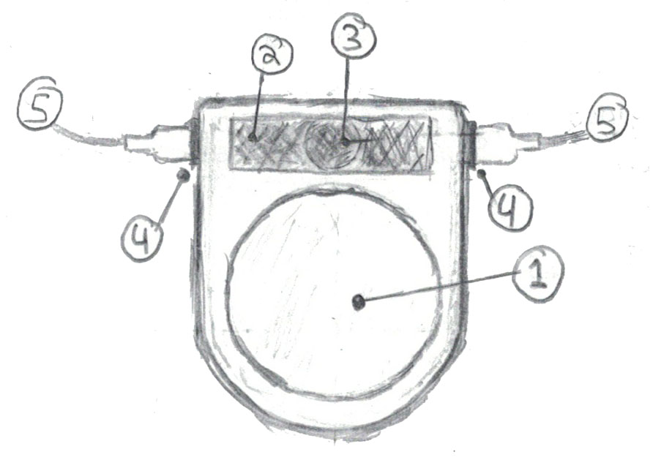
Industrial design
FRONT
Main Button
About the size of a quarter coin
Recessed to prevent accidental interaction
Translucent white polycarbonate
Ultra bright LED mounted underneath engages once the emergency beacon is activated
Large Matte Surface
For end user labeling of unit via marker or sticker
Mini Piezoelectric Siren
Engages once the emergency beacon is activated
Magnetic Safe Connector
Accepts connector from either a compatible earpiece/mic or a compatible earlobe sensor
Magnet feature allows the connection to be broken without damage to the device, accessories, or user (similar to Apple MagSafe)
Accessory Cable
Continues on to compatible earpiece/mic or compatible earlobe sensor
Notes:
The device is built from ABS injection molded plastic in a simple two piece chassis design.
The main button is translucent plastic with an LED mounted below the surface. The LED illuminates In a strobe pattern and the piezoelectric alarm sounds once the emergency beacon is activated. The LED also illuminates automatically to reflect power cycle and low battery warnings.
The earpiece/microphone and the earlobe sensor accessories can each be attached to either side of the unit so long as one connector has the earpiece and the other has the earlobe sensor.

Slide 16
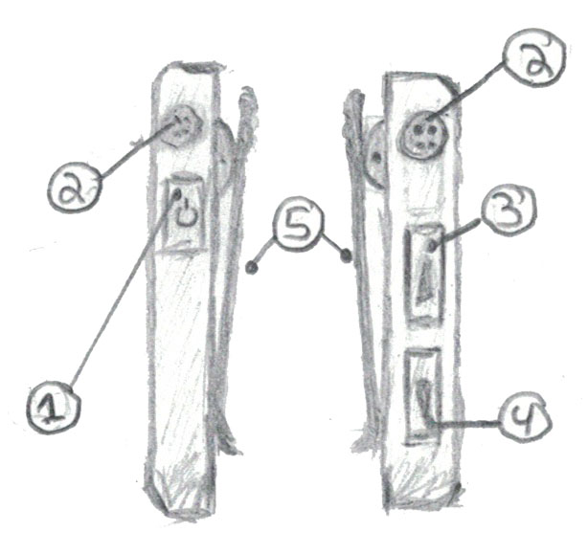
Industrial design
SIDES
Power Button
Recessed to prevent accidental interaction
One press powers on device
Press and hold for 5 seconds to power off device
Magnetic Safe Connector
Earpiece Volume Up Button
Recessed to prevent accidental interaction
Earpiece Volume Down Button
Recessed to prevent accidental interaction
Spring Powered Clip
Replaceable and reconfigurable clip allows for attachment to the back collar of a workers uniform or any other part of clothing
Notes:
The sides of the device feature the magnetic safe accessory connectors as well as recessed power, volume up and volume down buttons. Pressing the power button will turn it on while holding for 5 second will power the unit off.
A spring powered clip can also be seen in the profile sketch. Back Button devices ship with this simple clip by default since it’s the most versatile clip. It’s recommended to clip the unit to the back shirt collar since this position is out of the way of the worker and in a spot with easy access to both ears but the unit can also be clipped to any other part of the workers outfit.

Slide 17
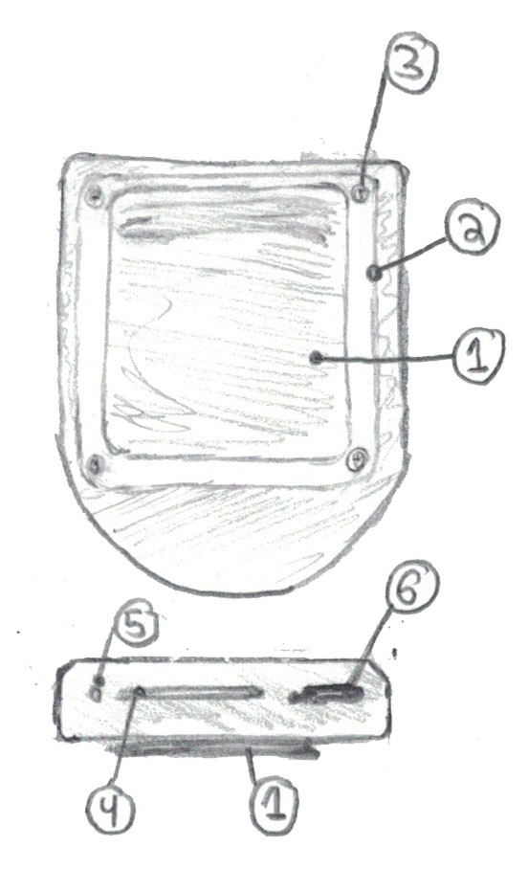
Industrial design
BACK & TOP
Spring Loaded Clip
Backplate
ABS plastic backplate covers the back of the chassis and includes the mounting option (default of which is a clothing clip)
Miniature Philips Screws
Method of removing the backplate to change backplate and mounting option
SIM Card Slot
SIM Card Ejection Port
Paper clip or needle is required to eject SIM card
USB-C charging port
Notes:
The Back Button device has a two part chassis with the front creating most of the shape and structure of the device. The second piece is a backplate which also includes the mounting option. In order to change the mounting option to something other than the standard clothing clip, the entire backplate must be removed via screwdriver and the new backplate attached the same way.
The device also features a SIM card slot on the top as well as a micro sized SIM card ejection port and a standard USB-C charging port.

Slide 18
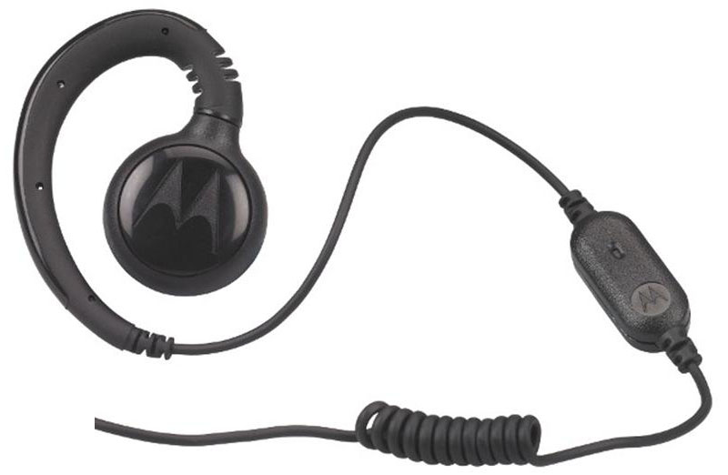
Industrial design
ACCESSORIES
Earpiece microphone combo
DSP is used to control the volume and clarity of the microphone in respect to environmental noise on the jobsite
Earlobe sensor for PPG readings
Pulse oximetry
Earlobe location is preferred for active environments
Notes:
The accessories would be purchased and rebranded from companies that have a proven track record in the industry. Some examples from Motorola and Biocom are pictured above but would obviously need to be custom manufactured to support the Back Button’s magnetic connector interface.
The earlobe sensor uses PPG to get vital signs such as pulse and oxygen saturation.

Slide 19
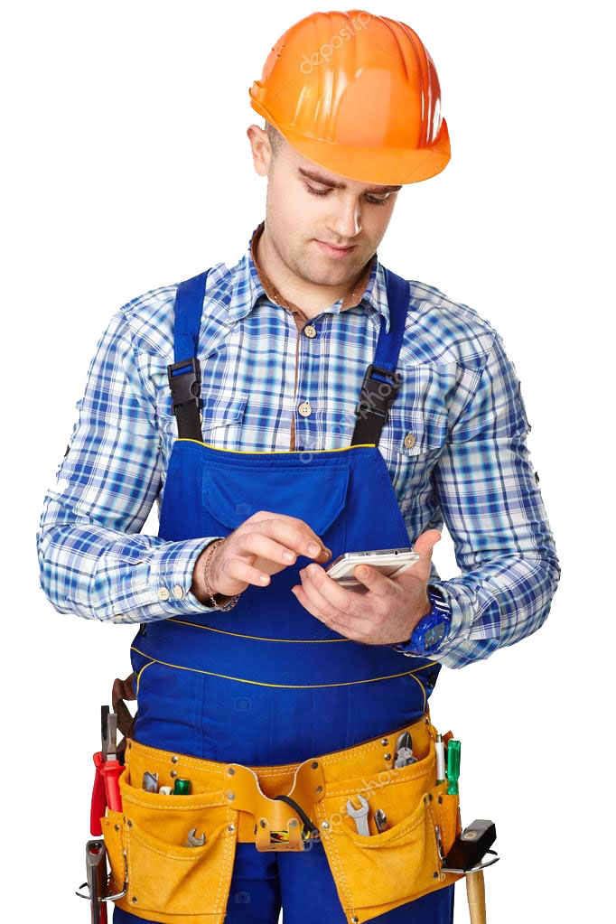
Foreman Mobile application
The Forman mobile app allows onsite management to interact with Back Button cloud services beyond the limitations of the Back Button edge devices
Notifications processed to text to speech on Back Button devices
Voice communication with any Back Button in the system via app GUI
Real time readings of battery and connection status’ of Back Button devices in the system
Real time notification and location data regarding emergency beacons
Real time physiological notifications regarding Back Button users/workers
Notes:
The Back Button device does nothing in regard to sending notifications. For this, onsite managers use a mobile app on iOS or android called Back Button Foreman.
This app allows onsite leaders to communicate with any and all Back Button devices in the system via their mobile device. It also enables them to issue notifications to any and all Back Button devices. The app also receives real time notifications on emergency beacons, battery, and connection status’ of Back Button devices in the system so management is able to see when a worker may be about to go offline.
Mangers also use this application to receive notifications of prolonged heightened physiological activity that way they can be notified when a worker may be over exerting themselves for too long and mitigate any potential risk accordingly.

Slide 20
Back button admin web app
Configuration and administration of a Back Button system
The Back Button system is configured and managed via web app
Initial setup of a Back Button device is simple
Insert an active SIM card and power on
Register the Back Button with the system’s account via the device serial number
Configure that specific device in the web app
In the Back Button Admin web app, management can…
Add and remove Back Buttons
Provision Foreman accounts and features for managers
Create teams of Back Buttons and team leaders
Configure thresholds for Forman mobile app physiological risk notifications
Configure custom 3 and 4 Back Button press features
Tend to billing and customer account configurations
Notes:
No notes here. Reading off the slide.

Slide 21
TECHNICAL ARCHITECTURE Overview
Core functionality is a product of cloud based services provided via a subscription membership
Onsite edge devices (Back Button and Foreman) work almost anywhere without the need for gateways thanks to the use of cellular communications
System configuration and setup must be done by administrators in Back Button Admin
Wi-Fi / Wired Internet
Back Button Admin Web App
Back Button Cloud Services
4G LTE / Cellular
Back Button Devices
Foreman Mobile App
Notes:
The communications backing the functionality of the Back Button system and ecosystem is all cloud based. Each Back Button device or Back Button ecosystem device must first be online to access any of the core services and functionality.
The Back Button wearable devices connect via 4G LTE. The Forman Mobile app connects however the host device connects to the web, for this we assume it’s a cell phone also connected via 4G LTE.
For the Back Button administrative web application we envision management using the application in a corporate office atmosphere via wi-fi or Ethernet.

Slide 22
CLOUD ARCHITECTURE
Push messaging / RTC Notification Partner
MongoDB Cluster
Application Infrastructure Cluster
Web RTC API
HTTP REST API
www
4G LTE
www
Ethernet Wi-Fi
Back Button Device
Foreman Mobile App
Admin Web App
Notes:
The cloud architecture is fairly simple with a Node powered application infrastructure that has a RESTful HTTP interface for the Back Button Admin web app and a WebRTC interface for the Back Button devices and Forman mobile app instances.
MongoDB is used to persist configuration data as well as historical data regarding notifications, beacon alerts, and physiological readings. A push messaging partner could be used for more efficient and cost effective implementation of real time push notifications to the Back Button devices and Forman mobile app instances.

Slide 23

Web RTC & Messaging
Voice communication between Back Button devices and between the Foreman app are conducted via WebRTC
For reliability, notifications are done via simple push notification. On notification, Back Button devices will play the related sound clip, or process text to speech.
Push notifications are also used for emergency beacons to notify other nearby workers of the incident location
On beacon activation, all Back Button devices in the system will receive the notification and beacon GPS location. The Back Button device will then compare the beacon location with its own to determine if it’s ‘nearby’ and play the appropriate sound clip
The emergency beacon siren and strobe can activate regardless of cellular connection or push notification success
Notes:
No notes here. Reading off the slide.

Slide 24

REST API & WEB APP
Management of the Back Button system is conducted via the Back Button Admin web app using a RESTful API design
Back Button devices connect to the cloud service (RTC) once a sim card is inserted and the unit powered on, but they are orphaned.
The unit must be registered with an account via the Back Button Admin web app. This is what associates that Back Button with the construction firm and their Back Button system.
Configurations in the Back Button Admin web app
Effect who the Back Button user has the ability to voice communicate with on the jobsite
Effect what notifications they’ll receive
Notes:
No notes here. Reading off the slide.

Slide 25
Going to market
Enterprise Sales
The Back Button customers are construction firms, so a commitment is required from the firm on an enterprise level.
To execute this we need talk to the customer to understand their needs and target marketing initiatives to that problem and how Back Button solves it.
Screen and test prototypes with small firms to be sure it serves the intended purpose and provides value
Conduct elicitation interviews with firms to determine the target price point and SaaS subscription style in regard to the value provided
Regardless, the Back Button device must provide some sort of monetary value to the construction firm by
Lowering cost of doing business
Or increasing revenue
The Back Button users are jobsite construction workers who enjoy using Back Buttons daily.
The device feature set must encourage jobsite workers (users) to use it daily that way the firm (customer) can realize the systems value.
Conduct elicitation, co-design, and field based focus groups of target users (jobsite workers) to ensure the product design encourages end users to use it when and as intended
Enterprise sales
Relationships need to be nurtured by sales reps who must convince purchasers that their firm needs this product by conducting
Product demonstrations
Case studies from proven successes with Back Buttons
Product trials
Notes:
No notes here. They would be too long so I would just adlib off the slide.

Slide 26

Going to market
Conference circuit
Back Button conference booths will increase exposure to business leaders in charge of purchasing and will jumpstart interest in Back Button systems as well as sales.
Many construction business leaders attend trade shows and conferences to learn about new tech and industry developments
A Back Button booth will help expose the product to the market and set the company and corporate team as thought leaders in the construction, construction risk, and construction safety space.
Notes:
No notes here. They would be too long so I would just adlib off the slide.

Slide 27
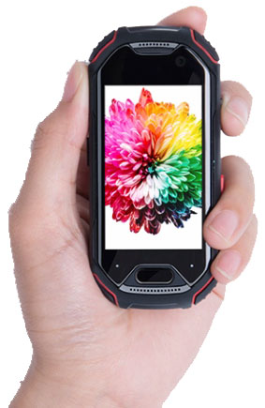
Going to market
Partnerships
Partnership opportunities could be realized in regard to accessories as well as platforms that run the Forman app…
Partnerships with rugged cellphone manufactures for ‘Foreman Certified’ phones that are officially recommended for use with the Foreman mobile app
Achieve brand and product exposure in the construction tech mobile device space
Partnerships with hardhat and construction clothing manufactures
Hard hats with custom back plates included for Back Button mounting compatibility
Hard hats that are designed with specific mounting points for Back Button clips
Clothing with specified mounting locations for the Back Button clip
Requires official open design specifications for Back Button compatibility
Achieve brand and product exposure in the construction clothing space
Notes:
No notes here. They would be too long so I would just adlib off the slide.

Slide 28
References and Image Sources
https://jobsite.procore.com/communication-failures-on-a-construction-jobsite
http://blog.mcrsafety.com/end-users/five-shocking-construction-injury-statistics
https://jobsite.procore.com/the-cost-of-employee-turnover
https://www.constructionjunkie.com/blog/2015/3/12/how-much-does-rework-really-cost-your-job-and-what-can-you-do-to-stop-it
http://biocomtech.com/products/stress-sweeper_hardware
http://www.techwholesale.com/motorola-hkln4513.html
https://www.conexpoconagg.com/
https://www.eiseverywhere.com/ehome/194634/440191/
https://www.irmi.com/conferences/construction-risk-conference
https://liliputing.com/2018/06/unihertz-atom-is-a-tiny-rugged-4g-smartphone-with-a-2-45-inch-display-crowdfunding.html
https://www.constructiongear.com/pyramex-ridgeline-hard-hat-4-point.html
https://medium.com/@avanthikameenakshi/building-restful-api-with-nodejs-and-mysql-in-10-min-ff740043d4be
https://webrtc.org/press/
https://www.rentacomputer.com/rentals/computers/laptops/rugged

